Slide 1


WMO Tropical Cyclone-Probabilistic
Forecast Products (TC-PFP) Pilot Project
Hui YU
Shanghai Typhoon Institute/CMA, WGTMR member
Project Team:
Chair: Jason Dunion, University of Miami/CIMAS – NOAA/AOML/HRD, WGTMR member
Members: Raghavendra Ashrit (NCMRWF India), Chris Davis (NCAR), Estelle De Coning (WMO), Anne-Claire Fontan (WMO), Helen Greatrex (Penn State Univ), John Methven (Univ of Reading), Helen Titley (UK Met Office), Munehiko Yamaguchi (WMO), Hui Yu (Shanghai Typhoon Institute, CMA), Zhuo Wang (Univ of Illinois)
ESCAP/WMO Typhoon Committee 16th Integrated Workshop
December 2, 2021

Slide 2

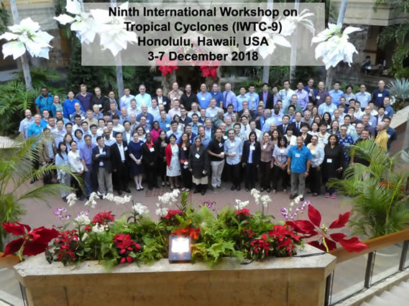
TC-PFP Pilot Project - Motivation
9th International Workshop on Tropical Cyclones (IWTC-9), Honolulu, HI. Dec 2018.
IWTC: a part of the WMO major quadrennial symposia & workshops
To bring forecasters and researchers together to summarize TC-related activities (operational forecasts, research outcomes, etc) during the four years between two adjacent events and make recommendations for future challenges.

Slide 3
TC-PFP Pilot Project - Motivation
IWTC-9 recommendations (a total of 35):
  19. Consider working toward replacing static cones of uncertainty with dynamic types, which can be ensemble-based or hybrid statistical and dynamical techniques.
  20. Include social science aspects and knowledge of ensemble and uncertainty as (mandatory/desirable) components of basic meteorological training under WMO.
  21. Encourage access to forecast data (deterministic and ensemble; global/regional) and international data sets, particularly TIGGE, to facilitate research and operational use of ensemble forecasts.
  35. Encourage the opportunity for major interdisciplinary research activity in the Asian Region aimed at improving the information available to typhoon forecasters and providing the research needed to enhance the communication and utility of typhoon warnings. This should be a pilot project for the seamless Global Data Processing and Forecasting System …
  Explore the use of dynamic cones of uncertainty that incorporate model
  ensemble information and integrate social science & basic meteorological training

Slide 4
TC-PFP Pilot Project – Overview
  What is the Goal of the TC-PFP Project?
  To coordinate across RSMCs and other forecast & NWP centers to identify best practice guidance for probabilistic tropical cyclone forecasts.
Where does the TC-PFP Project fit within WMO?
Under the umbrella of the Typhoon Landfall Forecast Demonstration Project (TLFDP), led by the WWRP Working Group on Tropical Meteorology Research (WGTMR)
A pilot project of WMO Seamless Global Data-processing and Forecasting System (S/GDPFS)

Slide 5
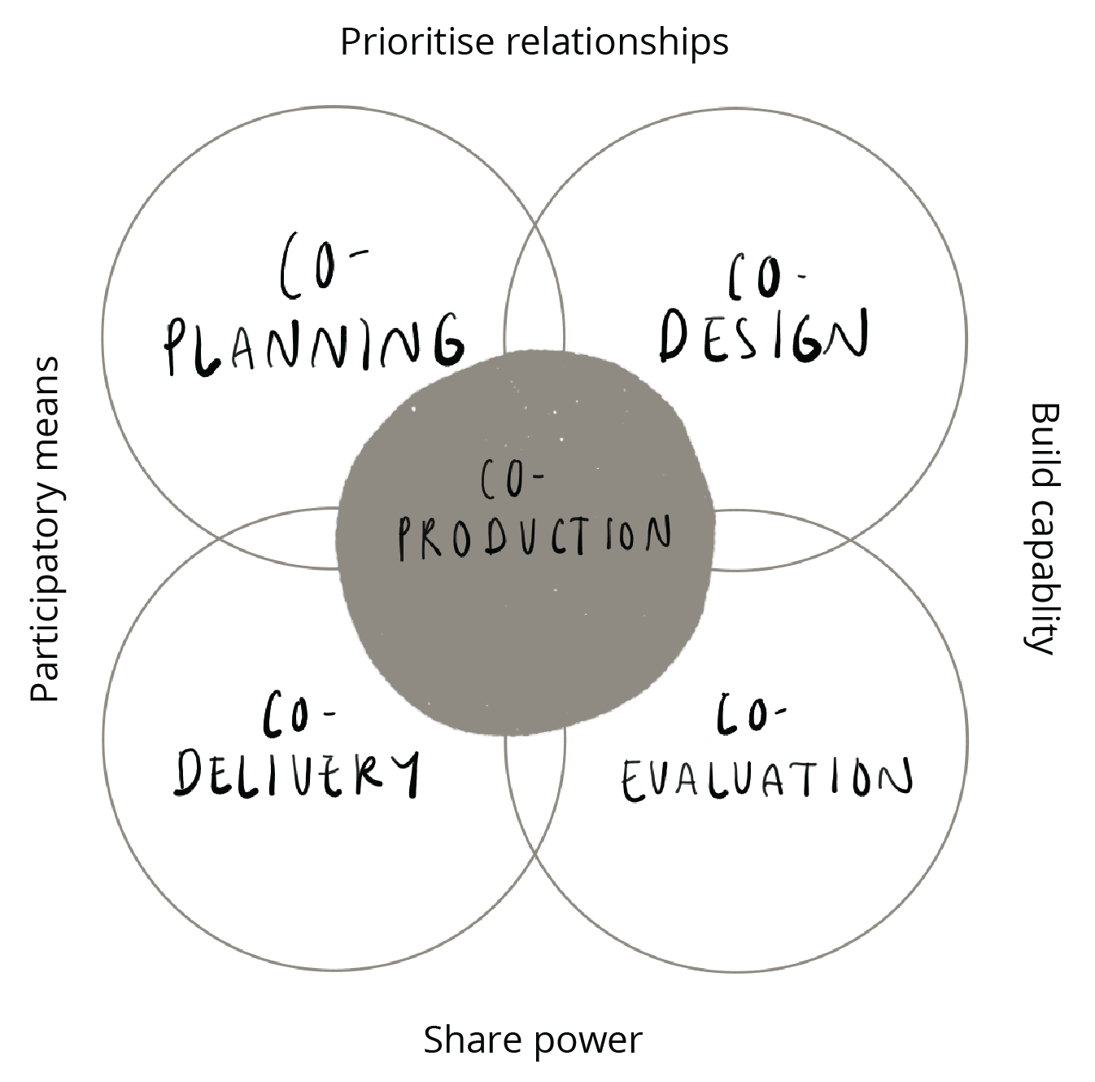
TC-PFP Pilot Project – Overview
This effort will be implemented in 3 phases, with an initial focus on Phase 1:
  Phase 1: Work with forecast centers to identify best practices of a value-cycle approach to probabilistic forecasts of TC formation and position.
  Phase 2: Work with forecast centers to identify best practices of a value-cycle approach to probabilistic forecasts of TC intensity and structure.
  Phase: 3: Work with forecast centers to identify best practices of a value-cycle approach to probabilistic forecasts of TC-related rainfall and storm surge.
Impact-based
forecasting
Value cycle approach
  Users are not “end users” but rather valuable partners in co-designing product information that is useful for a variety of situations.
  Collaborating with WMO’s Societal & Economic Research Applications (SERA) group
Assessing whether forecasts add value to a user
Forecast
communication

Slide 6
TC-PFP Pilot Project – Status
Phase 1: Tropical Cyclone Formation and Position
Project Accomplishments
Identify RSMCs and forecast centers that might be interested in this effort (Jan-Feb 2021)
Reach out to RSMCs and forecast centers to learn more about their current efforts & future plans to produce probabilistic forecasts, their customers, their various forecast challenges, and to gauge their interest in this project (Feb-May 2021)
Plan a WMO-sponsored workshop that focusses on identifying best practice guidance for probabilistic forecasts of TC formation and position and invite interested forecast and NWP centers to participate (a 3-day virtual workshop was held on June 15, 17-18, 2021)

Slide 7
2021 TC-PFP Workshop (15, 17-18 Jun 2021)
Workshop Goal:
Coordinate across RSMCs and other centers to identify best practice guidance for probabilistic forecasts of TC formation and position…help us identify what directions we want to go with this effort.
  Workshop Format (keynote presentations >> breakout groups >> plenary discussions)
  Day-1: Tue 15 June, 1230-1430 UTC
    Topic: Current & planned probabilistic forecast products
    Invited presentation by Andrew Burton (BoM Australia) and Jonathan Vigh (NCAR)
  Day-2: Thu 17 June, 1230-1430 UTC
    Topic: Understanding & communicating probabilistic forecasts
    Invited presentation by Helen Greatrex (Penn State Univ) and Mark DeMaria (CIRA/Colorado State Univ)
  Day-3: Fri 18 June, 1230-1430 UTC
    Topic: Resources for producing probabilistic forecasts
    Invited presentation by Helen Titley (UK Met Office), Fernando Prates (ECMWF), and Ryan Torn (Univ at Albany-SUNY)

Slide 8
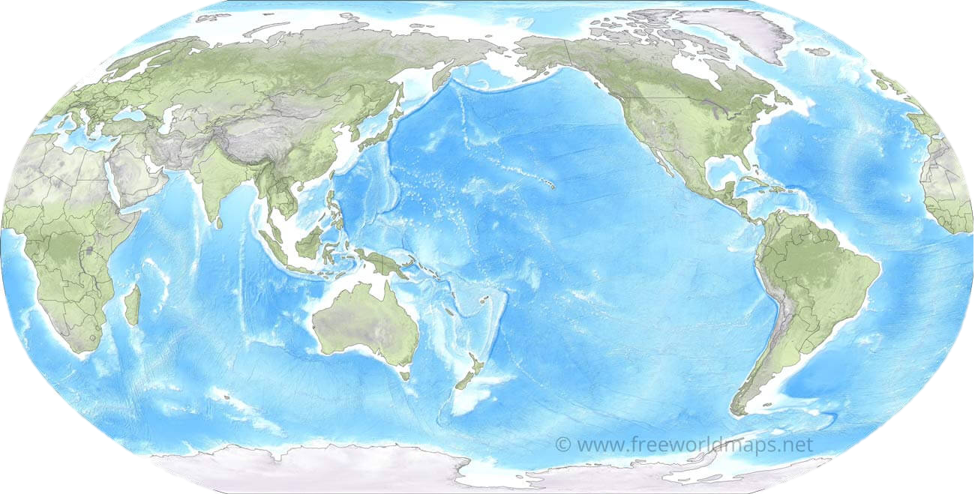
2021 TC-PFP 3-day Workshop: 15, 17-18 June 2021
2021 TC-PFP Workshop Participants
100+ participants, 16 countries, 14 time zones
TC-PFP Workshop Participants

Slide 9
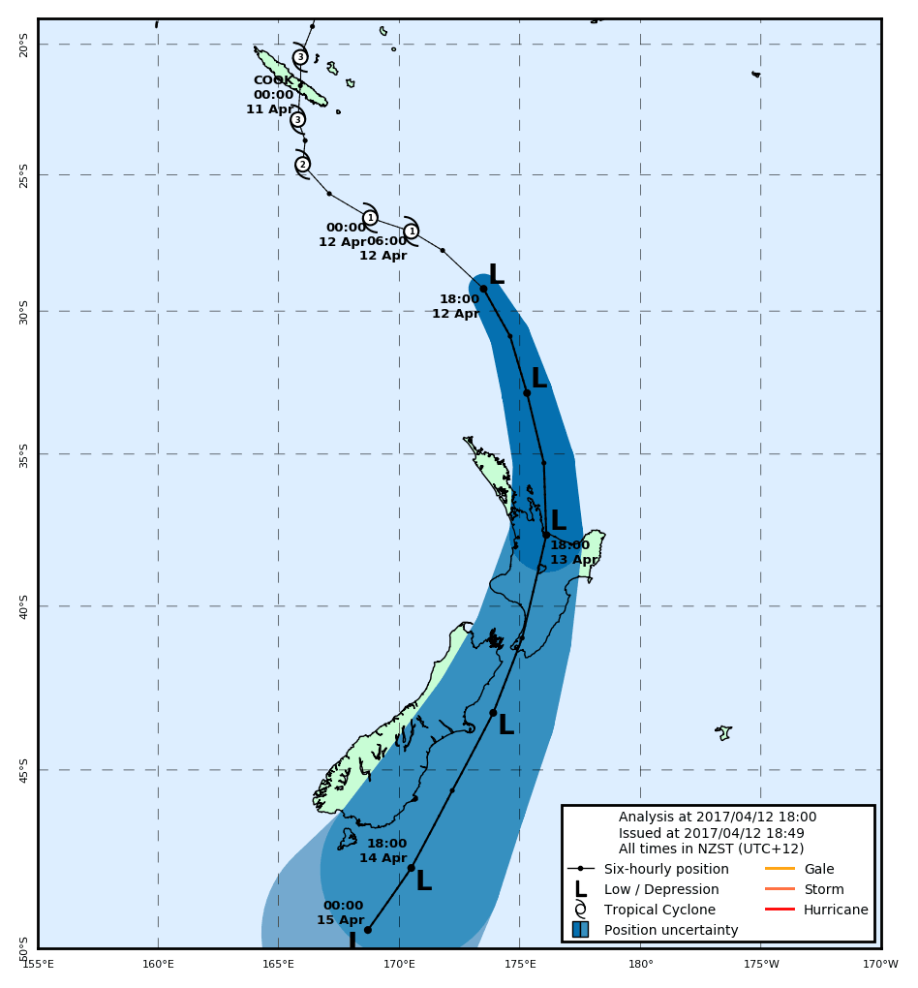
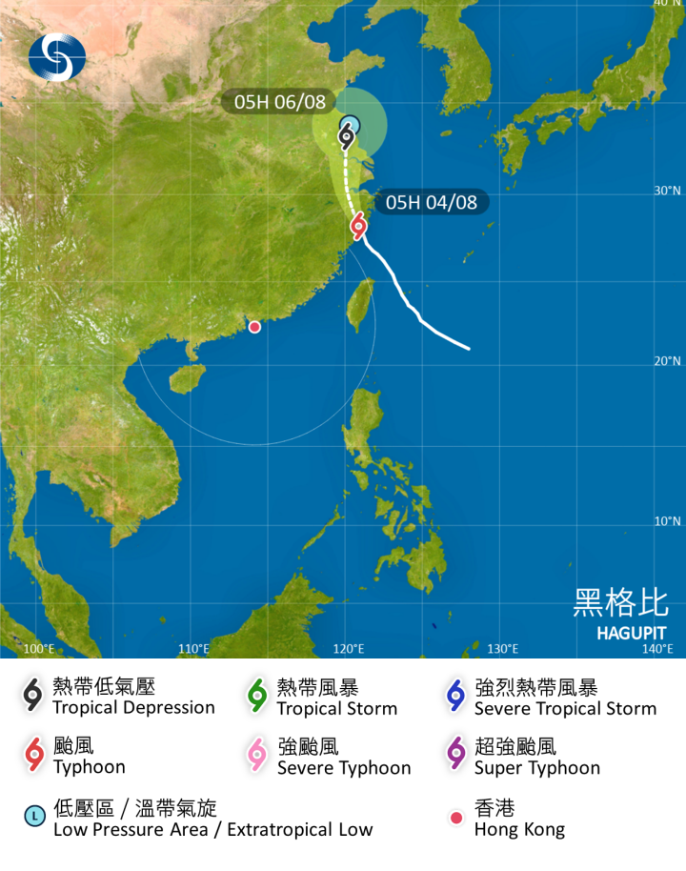
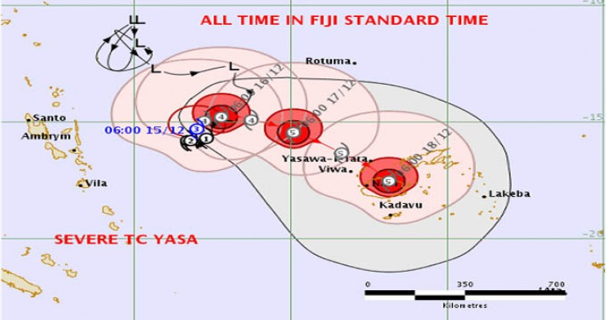
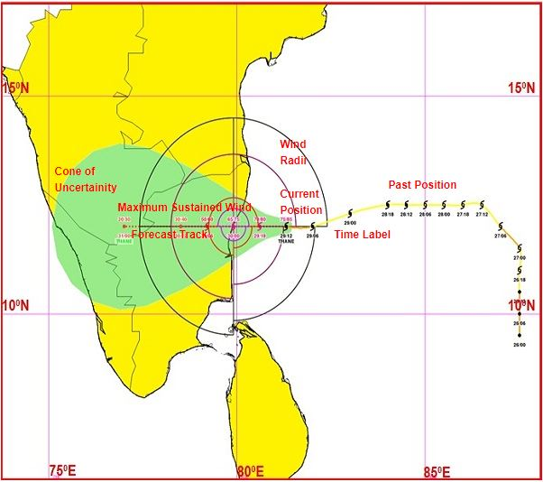
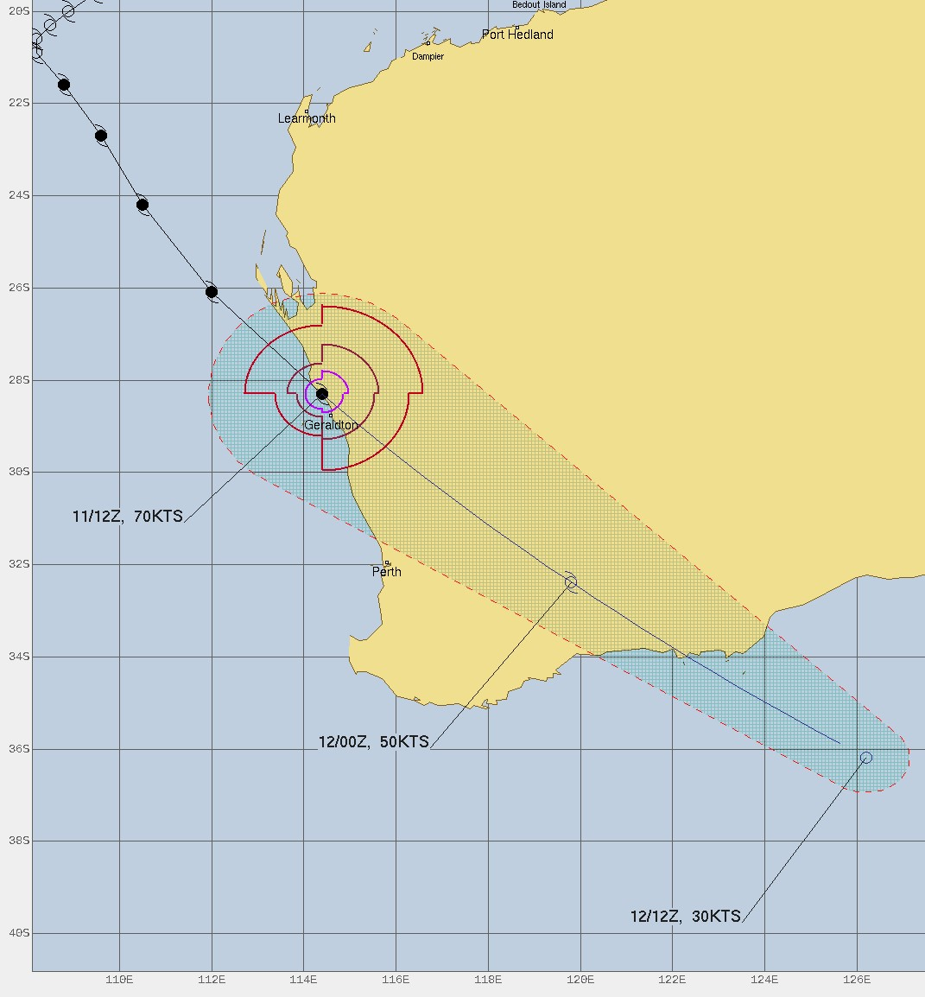
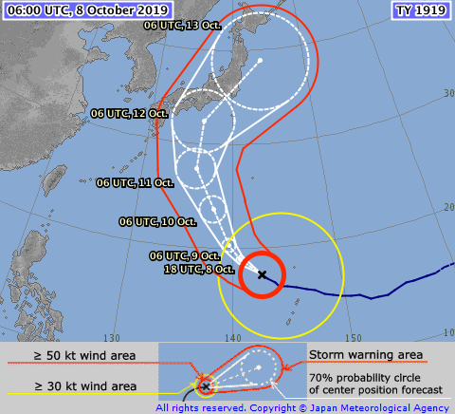
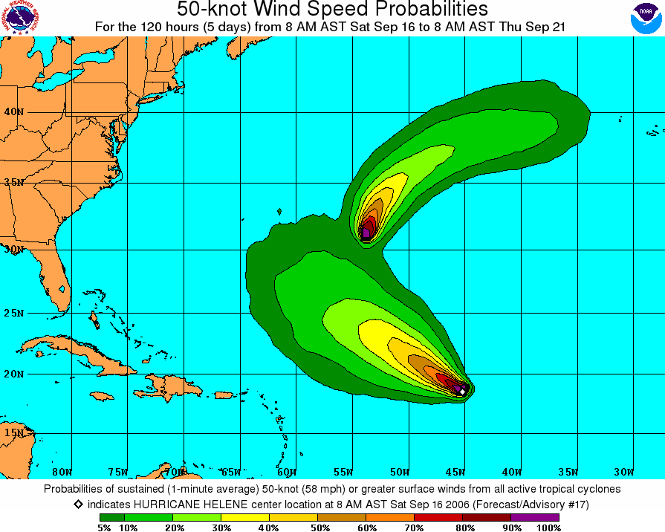
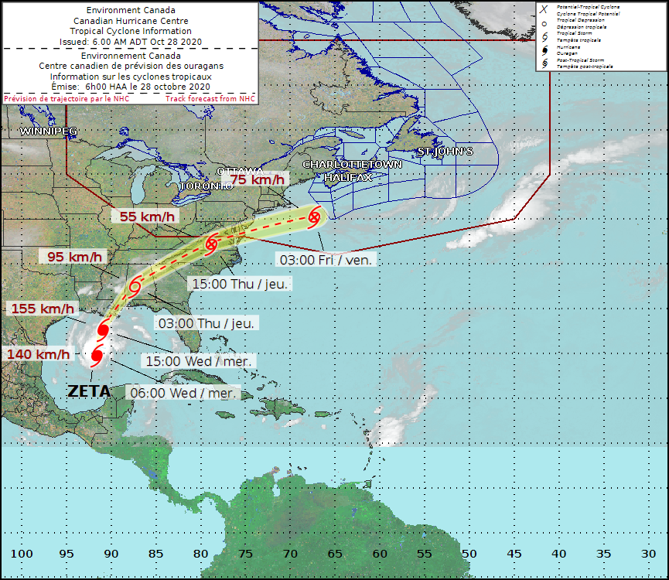
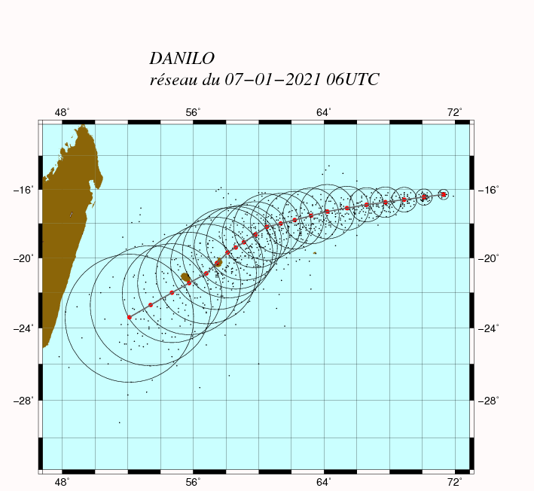
Sample of Current Operational TC Track Forecast Products
(Extracted from the presentation by Andrew Burton and Jonathan Vigh on 15 June, 2021)
Most centers use cones/circles to express forecast uncertainty
The size of the cones/circles is determined in several different ways.
  Subjective assessment - New Zealand MetService
  Static cones based on past performance – HKO, CMA, RSMC Nadi, RSMC New Delhi, JTWC
  Climatological cones with subjective modification – CHC
  Objective statistical ensemble approach – RSMC Miami
  Dynamical approach – RSMC Tokyo
  Hybrid statistical-dynamical approach – RSMC La Reunion, BOM

Slide 10
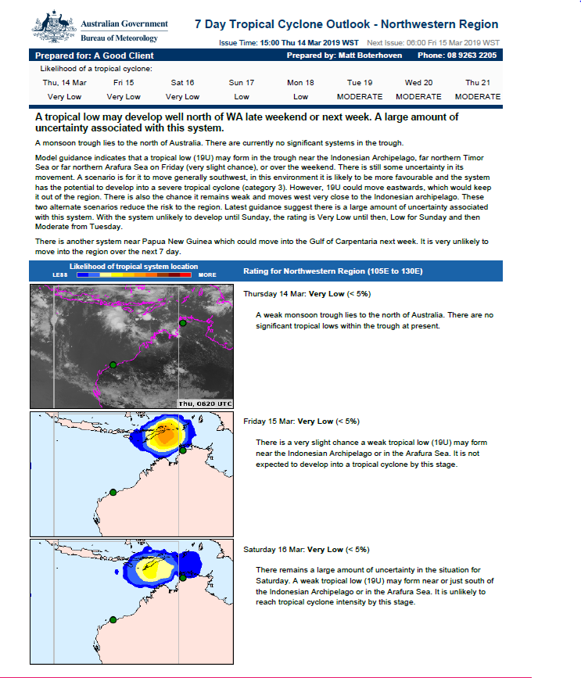
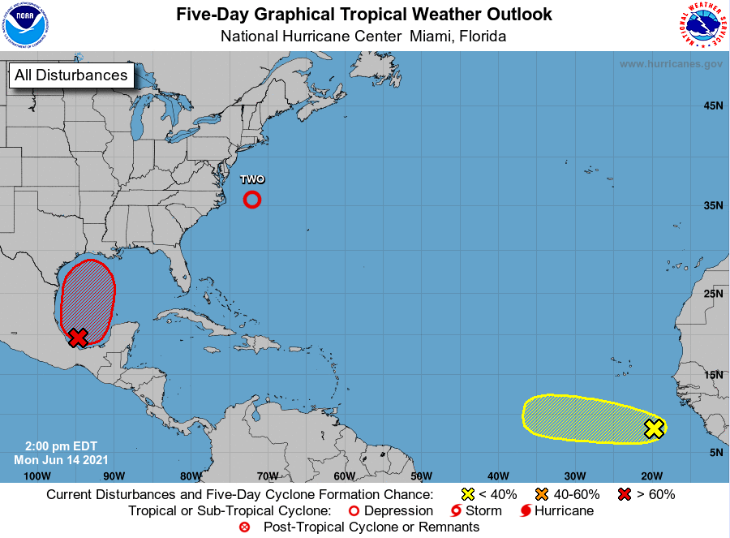
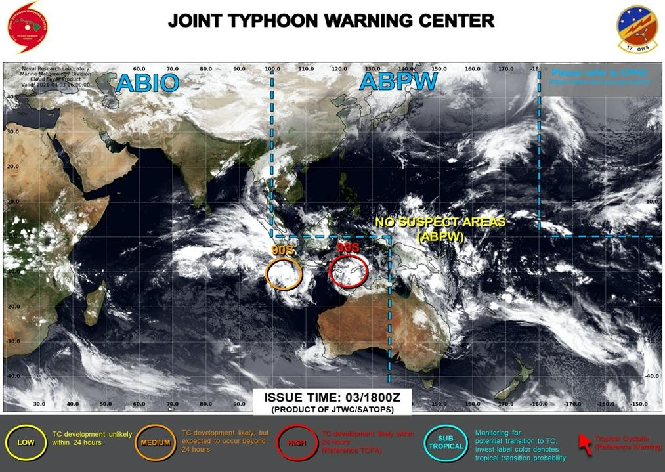
Thoughts About Operational TC Genesis Forecast Products
(Extracted from the presentation by Andrew Burton and Jonathan Vigh on 15 June, 2021)
Formation is a scientifically tougher problem than track
  Requires disturbance/pre-disturbance tracking
Cumulative vs. time-based approaches
Graphical products seem to be key to public understanding
Machine-readable formats recommended for verification

Slide 11
Possible future directions - Physical Science
(based on break-out group discussion notes)
Outreach, training and communication of verification to users will lead to better understanding of probabilistic products.
Currently, operational forecast products are mainly based on graphics, but the combination of graphics and text may be one way to provide users with more appropriate information about various situations, including bifurcation, and to promote the use of ensemble forecasts at operations.
One approach to promote the use of ensembles may start from recognizing the value of information of certainty rather than information of uncertainty (need an incentive to use ensembles).
In considering best practices, research and development on calibration (when ECMWF model is upgraded, TC tracks are generated for Reforecast (20years) 11mem. To be released in future), weighting, best combinations, etc. are needed (efforts such as the Lead Center to validate tropical cyclone ensemble forecasts are one solution).

Slide 12
Possible future directions - Social Science
(based on break-out group discussion notes)
Co-design of products between the provider and user builds a common understanding of needs, capabilities and limitations. Engagement of social scientists with product design at NHC, Argentina Weather Service is a good example.
Various approaches to learn users’ needs: Pre- and post-season meeting/workshop with users, use of social media and AI/ML technologies, post-storm survey and assessment by social scientists.
While limited resource, a community-wide approach with participation of the stakeholders from the public and private sectors, as well as academia and civil society is desirable.

Slide 13
Possible future directions - Resources
(based on break-out group discussion notes)
Build/improve a database where users can retrieve necessary data in a stable and timeliness manner (could be a cross-cutting effort with Global Data-Processing and Forecasting System: GDPFS).
Data format and preparing necessary software (decoder/encoder) are also very important so that the data can be used by a large number of people, including operational centers, researchers, academia, private sectors etc.
Augmentation of data (e.g., wind radii, genesis) is necessary for successful implementation of the project and promote R2O transfer (WWRP/TIGGE panel takes a lead).

Slide 14
What’s next for TC-PFP
A post workshop survey was sent to workshop participants (October 2021)
  Collect comments & suggestions re: the format, break-out groups, etc.
  Understand what worked well and identify areas for improvement
A writing team will develop the best practice guidance
  Guidance based on the workshop discussions and the post-workshop survey
    Participants were contacted in early Nov to gauge their interest in joining a writing team
Guiding a WMO-funded project to address scientific work related to TC-PFP
  Project goal: quantify, in a few pertinent model ensemble systems, the impact of different TC tracking methods (i.e., trackers) on forecasts of storm track & intensity
  PI: John Methven, University of Reading, UK
A project summary will be presented at IWTC-10 in Dec 2022
  A session will be scheduled on TC-PFP at IWTC-10
  By IWTC-10, TC-PFP will transit from Phase 1 to Phase 2 (TC intensity & structure)

Slide 15
Thank You
The WMO WWRP TC-PFP project highlighted in the
October 2021 issue of WMO’s MeteoWorld: https://public.wmo.int/en/resources/MeteoWorld#tophome

